Slide 1
Supervised4 Generalized Additive Models
資料科學 Data Science
張家銘 Jia-Ming Chang
政治大學資訊科學系/NCCU.CS
The slide isonly for educational purposes. If any infringement, please contact me, we will correct immediately.

Slide 2
Copyright declaration 版權說明
Some of the figures in this presentation are taken from "An Introduction to Statistical Learning, with applications in R" (Springer, 2013) with permission from the authors: G. James, D. Witten, T. Hastie and R. Tibshirani.
The web site of the book
The credit of individual is indicated in the bottom part of the slide.
ie.,

Slide 3
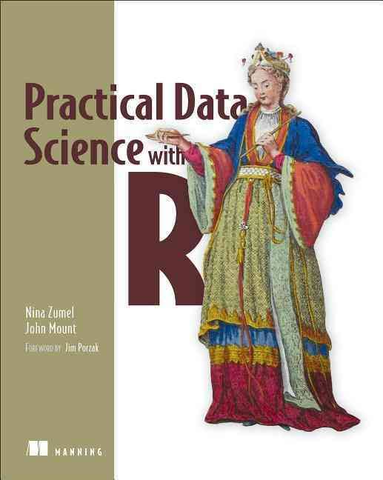
Copyright declaration 版權說明
Some of the figures in this presentation are taken from "Practical Data Science with R (Manning, 2019)”
The web site of the book
The credit of individual is indicated in the bottom part of the slide.
ie.,

Slide 4
Copyright declaration 版權說明
Some of the figures in this presentation are taken from "R for Data Science” under the Creative Commons Attribution-NonCommercial-NoDerivs 3.0 License.
The web site of the book
The credit of individual is indicated in the bottom part.
ie.,

Slide 5
Recap for the last week

Slide 6
Linear and logistic regression
Extracting relations and advice from functional models
linear regression
predict quantities
Interpreting the diagnostics from lm call
logistic regression
predict probabilities or categories
Interpreting the diagnostics from glm call
Practical Data Science with R by Nina Zumel, John Mount

Slide 7
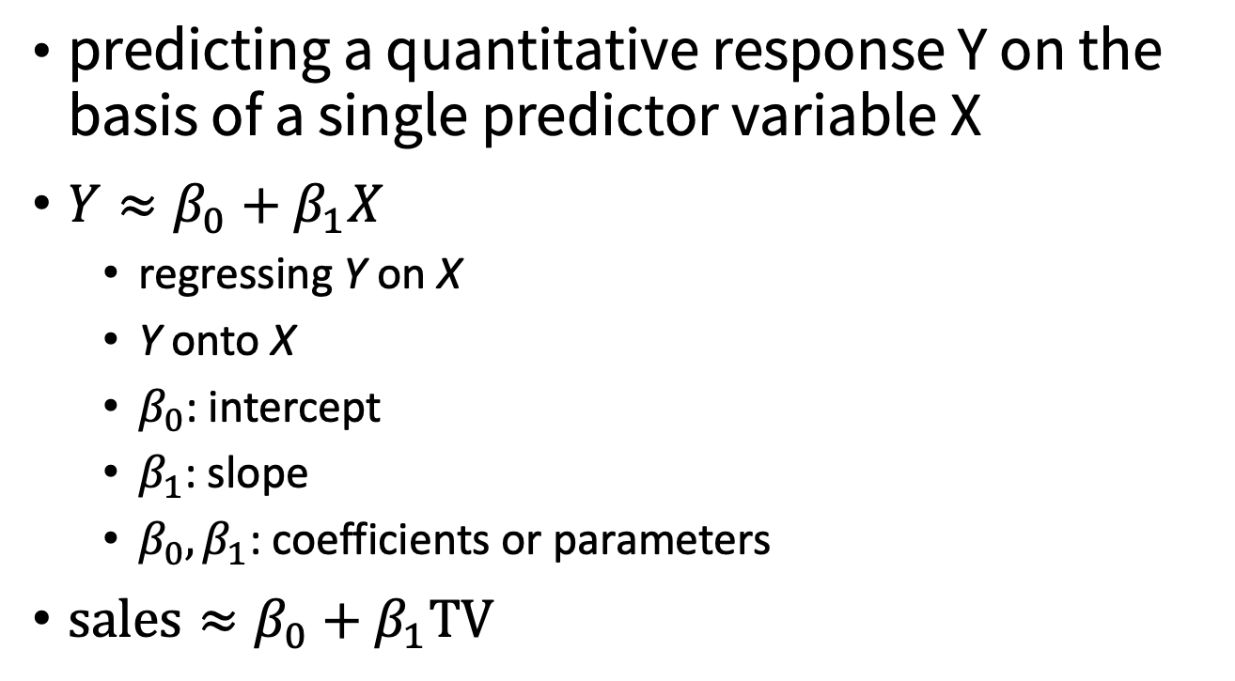
Simple Linear Regression
predicting a quantitative response Y on the basis of a single predictor variable X
$Y≈β_{0}+β_{1}X$
regressing Y on X
Y onto X
$β_{0}$: intercept
$β_{1}$: slope
$β_{0},β_{1}$: coefficients or parameters
$\text{sales}≈β_{0}+β_{1}\text{TV}$

Slide 8
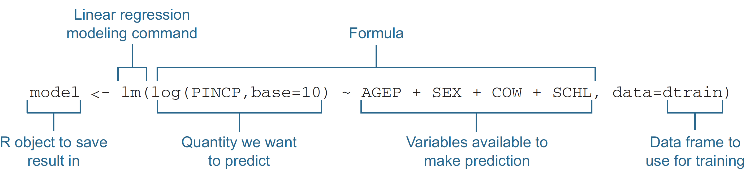
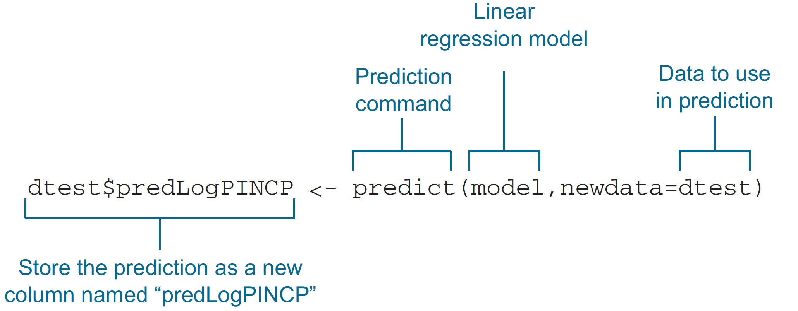
Building a linear model using the lm() command
Figure 7.2 & 7.3, Practical Data Science with R by Nina Zumel, John Mount

Slide 9
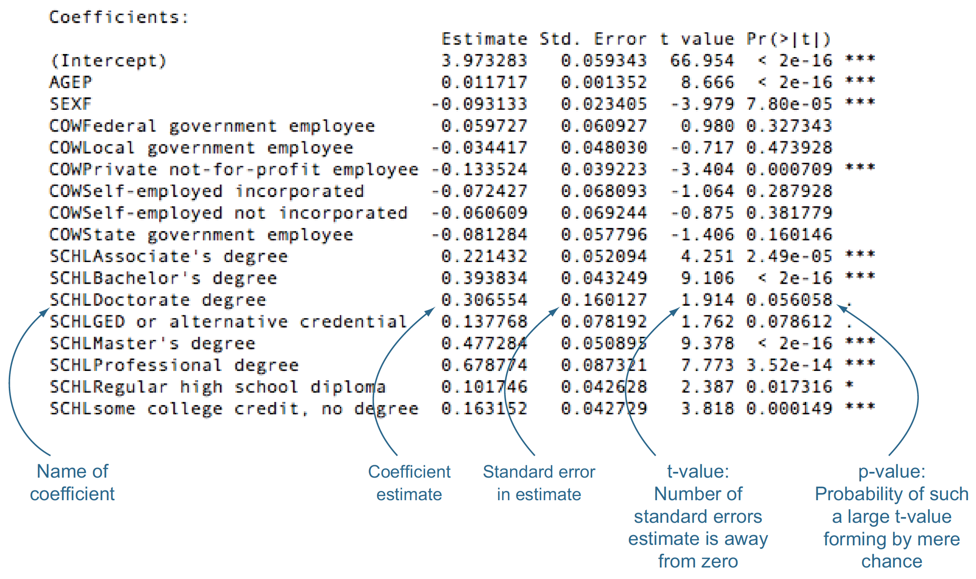
The Coefficients table
p-value : >=0.05, is not to be trusted
Figure 7.8, Practical Data Science with R by Nina Zumel, John Mount

Slide 10
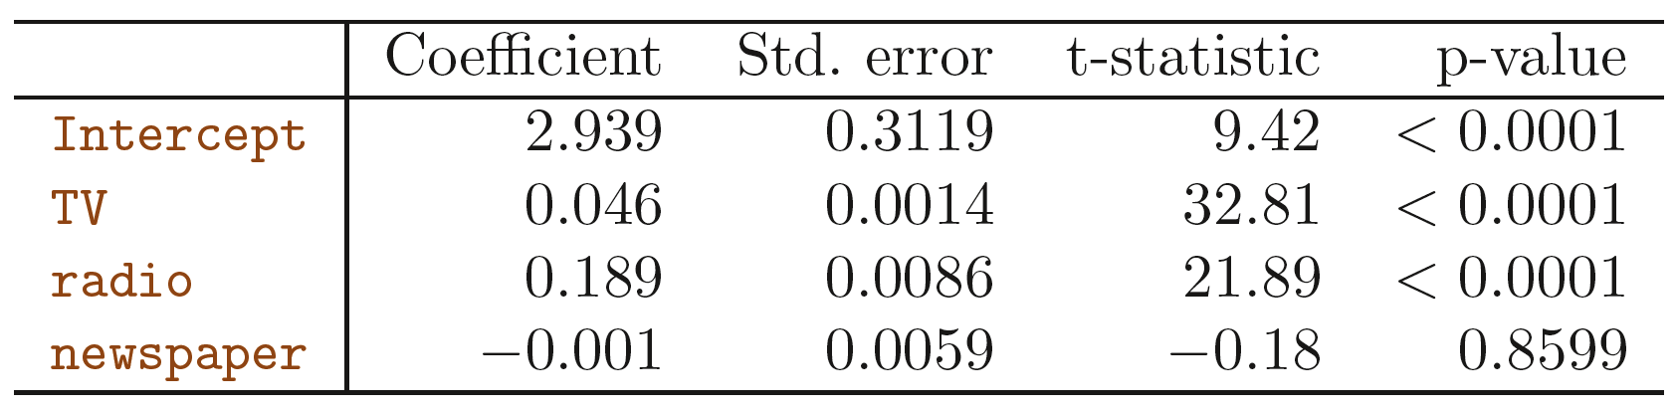
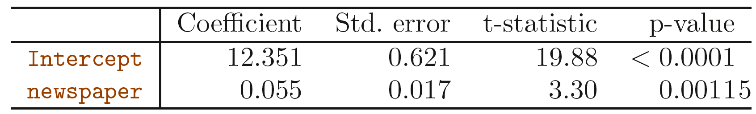
Multiple Linear Regression vs. Separate simple linear regression
the coefficient for newspaper represents the average effect of increasing newspaper spending by $1000 while holding TV and radio fixed.
The slope term represents the average effect of a $1000 increase in newspaper advertising, ignoring other predictors such as TV and radio
An Introduction to Statistical Learning with Applications in R by Gareth James, Daniela Witten, Trevor Hastie, Robert Tibshirani

Slide 11
R ² discussion on Sales example
R ² = 0.61
only TV as a predictor
R ² = 0. 89719
the model: TV + radio to predict sales
R ² = 0. 8972
TV + radio + newspaper to predict sales
tiny increase in R² => newspaper can be dropped from the model
An Introduction to Statistical Learning with Applications in R by Gareth James, Daniela Witten, Trevor Hastie, Robert Tibshirani

Slide 12
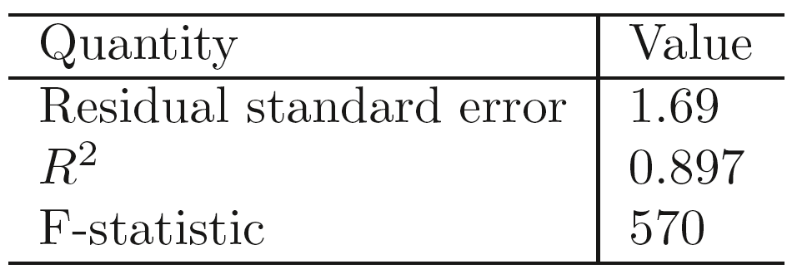
F-statistic @ Sales example
F-statistic is 570. Since this is far larger than 1
=> against the null hypothesis H₀
=> at least one of the advertising media must be related to sales
An Introduction to Statistical Learning with Applications in R by Gareth James, Daniela Witten, Trevor Hastie, Robert Tibshirani

Slide 13
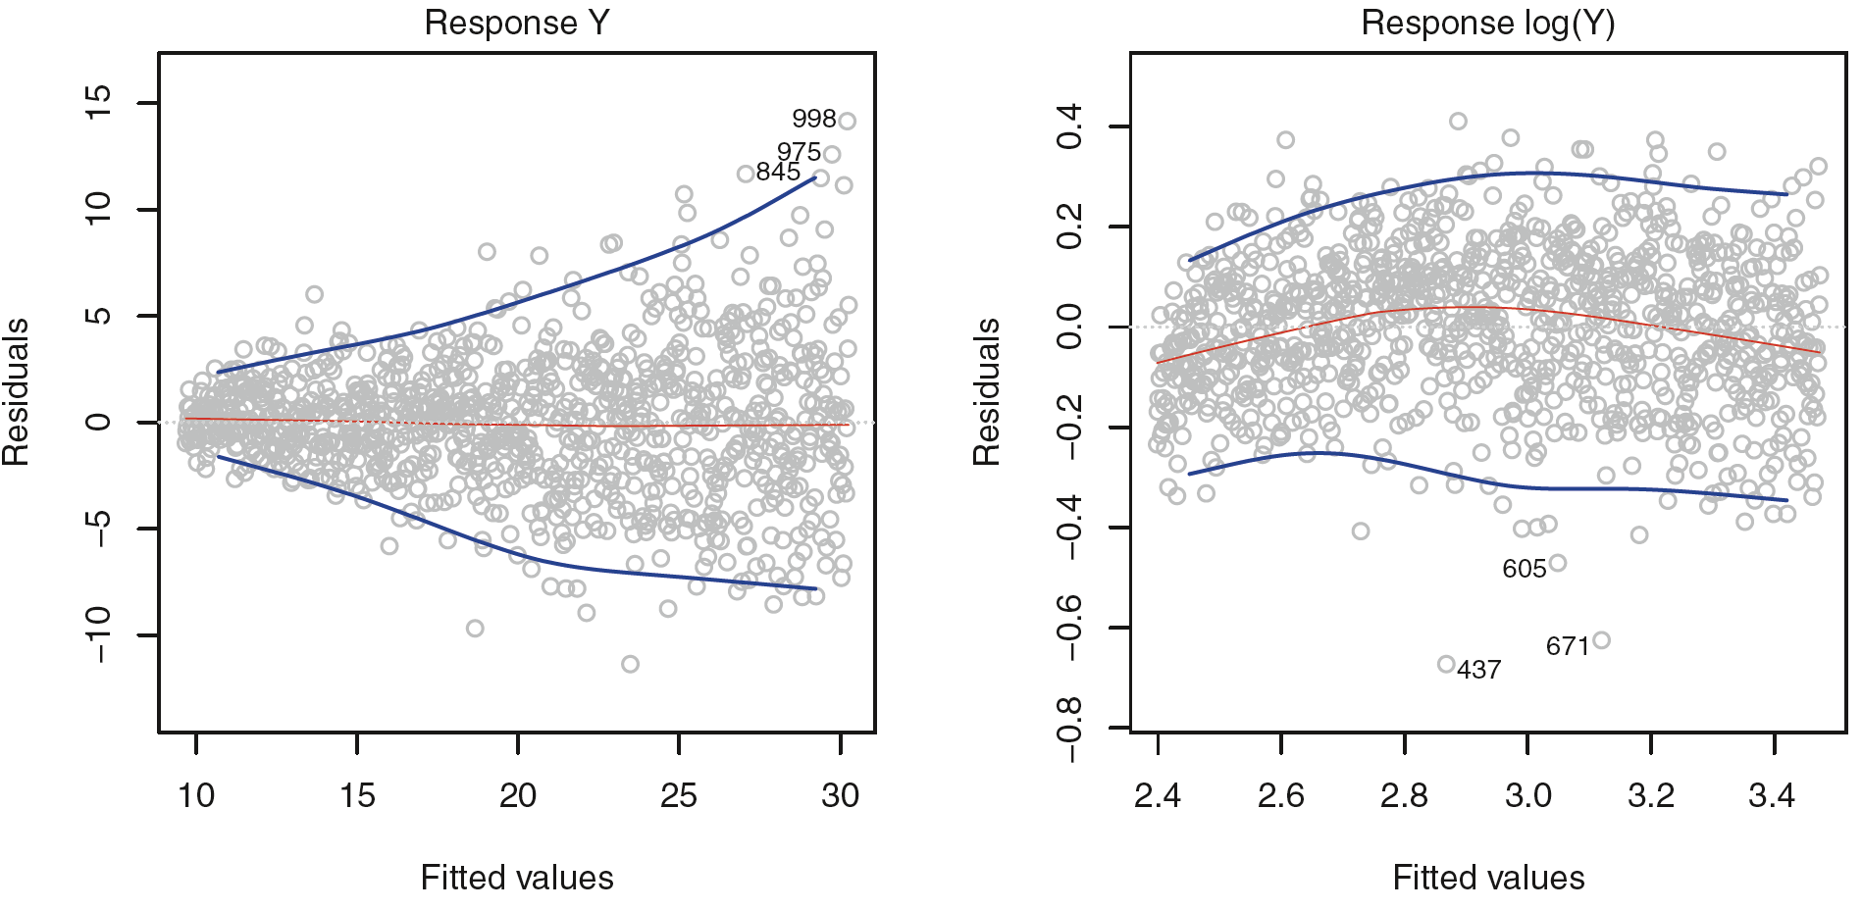
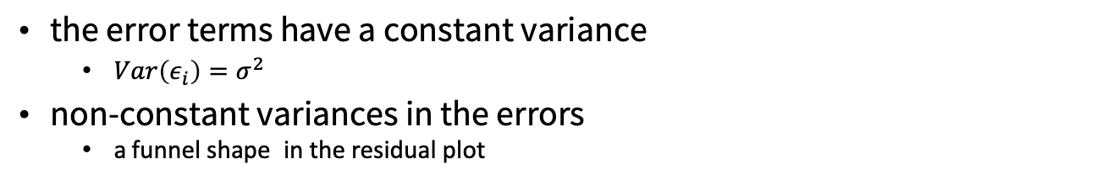
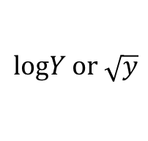
Non-constant Variance of Error Terms
the error terms have a constant variance
$Var\left(ε_{i}\right)=σ^{2}$
non-constant variances in the errors
a funnel shape in the residual plot
$$\text{log}Y \text{or} \sqrt{y}$$
Figure 3.11, An Introduction to Statistical Learning with Applications in R by Gareth James, Daniela Witten, Trevor Hastie, Robert Tibshirani

Slide 14
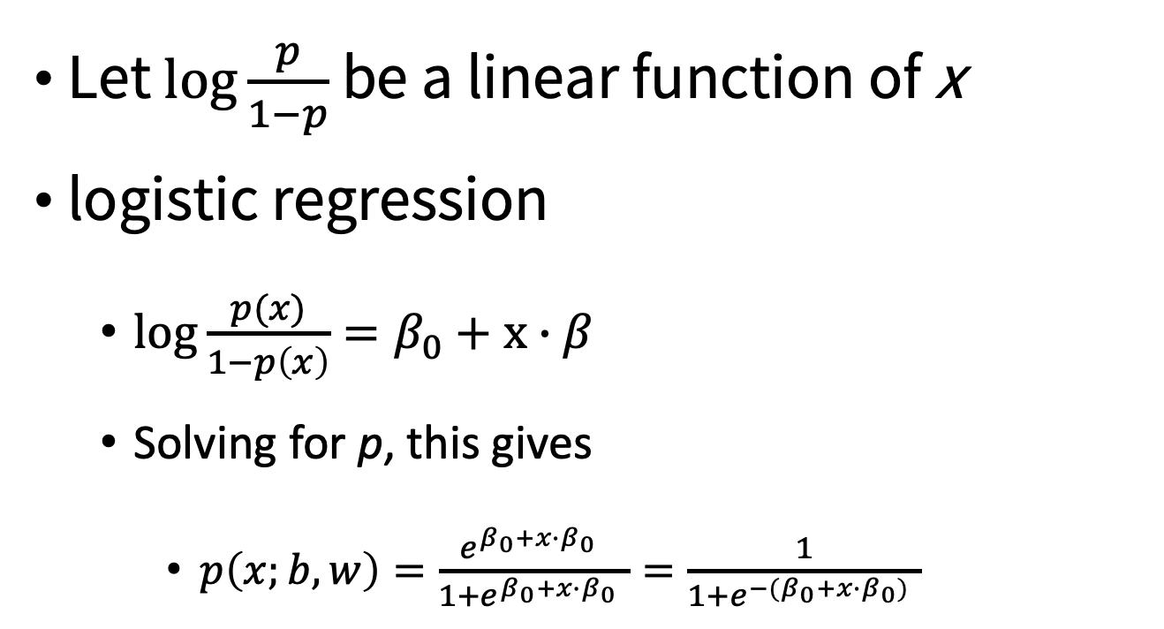
Logistic (or logit) transformation
Let $\log{\frac{p}{1−p}}$ be a linear function of x
logistic regression
$\log{\frac{p(x)}{1−p\left(x\right)}=β_{0}}+x∙β$
Solving for p, this gives
$p\left(x;b,w\right)=\frac{{e^{β_{0}+x∙β_{0}}}^{ }}{1+{e^{β_{0}+x∙β_{0}}}^{ }}=\frac{1}{1+{e^{{−(β}_{0}+x∙β_{0})}}^{ }}$
Credit by http://www.stat.cmu.edu/~cshalizi/uADA/12/lectures/ch12.pdf

Slide 15
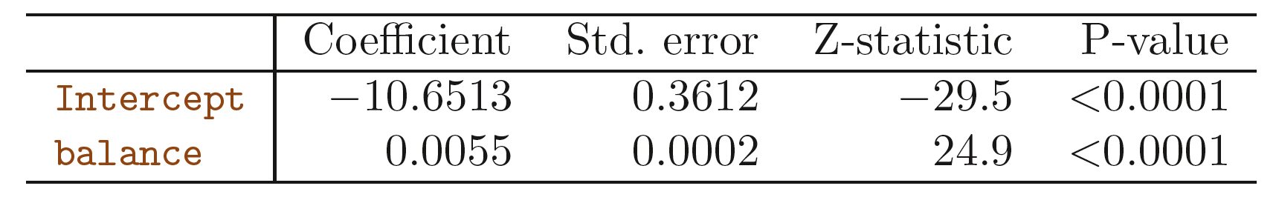
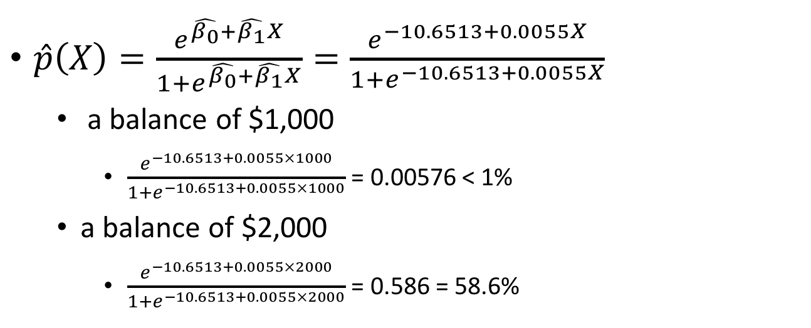
Making Predictions
$\hat{p}\left(X\right)=\frac{e^{\hat{β_{0}}+\hat{β_{1}}X}}{1+e^{\hat{β_{0}}+\hat{β_{1}}X}}=\frac{e^{−10.6513+0.0055X}}{1+e^{−10.6513+0.0055X}}$
a balance of $1,000
$\frac{e^{−10.6513+0.0055×1000}}{1+e^{−10.6513+0.0055×1000}}$ = 0.00576 < 1%
a balance of $2,000
$\frac{e^{−10.6513+0.0055×2000}}{1+e^{−10.6513+0.0055×2000}}$ = 0.586 = 58.6%
An Introduction to Statistical Learning with Applications in R by Gareth James, Daniela Witten, Trevor Hastie, Robert Tibshirani

Slide 16
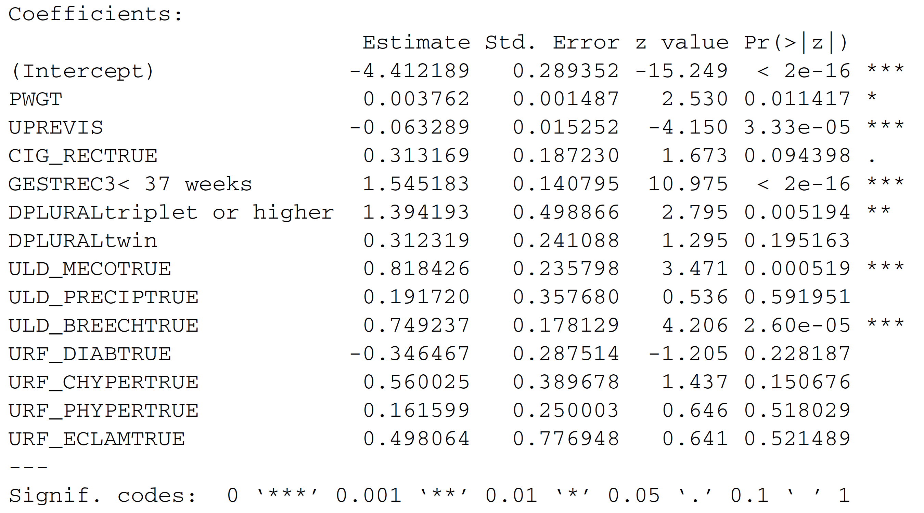
Characterizing coefficients
The Summary Coefficients Table
Practical Data Science with R by Nina Zumel, John Mount

Slide 17
null deviance VS residual deviance
Calculating the significance of the observed fit
delDev <- null.dev - resid.dev
deldf <- df.null - df.model
p <- pchisq(delDev, deldf, lower.tail=F)
p-value?
it’s extremely unlikely that we could’ve seen this much reduction in deviance by chance.
Practical Data Science with R by Nina Zumel, John Mount

Slide 18
P-value & the pseudo R-squared
The good p-value but the poor pseudo R-squared
The good p-value
the model is legitimate, it gives us more information than the average rate of at-risk births does alone.
The poor pseudo R-squared
the model isn’t giving us enough information to predict at-risk births with high reliability.
Practical Data Science with R by Nina Zumel, John Mount

Slide 19
P-value & the pseudo R-squared
A bad p-vlaue but a good pseudo R-squared (on the training data)
an indication of overfit
it’s a good idea to check both
check the pseudo R-squared of the model on both training and test data.
Practical Data Science with R by Nina Zumel, John Mount

Slide 20
Key takeaways
Functional models allow you to better explore how changes in inputs affect predictions.
Linear regression is a good first technique for modeling quantities.
Logistic regression is good first technique for modeling probabilities.
Models with simple forms come with very powerful summaries and diagnostics.
Practical Data Science with R by Nina Zumel, John Mount

Slide 21
Today
Chp. 9: Exploring advanced methods
Chp 7. Moving Beyond Linearity

Slide 22
Weaknesses of the basic approaches
Training variance
Reducing training variance with bagging and random forests
Linearly inseparable data
Increasing data separation with kernel methods
Modeling complex decision boundaries with support vector machines
Non-monotone effects
Learning non-monotone relationships with generalized additive models
Practical Data Science with R by Nina Zumel, John Mount

Slide 23
Training variance
Training variance is when small changes in the makeup of the training set result in models that make substantially different predictions.
Decision trees can exhibit this effect.
Both bagging and random forests can reduce training variance and sensitivity to overfitting.
Practical Data Science with R by Nina Zumel, John Mount

Slide 24
Linearly inseparable data
Often the concept we’re trying to learn is not a linear combination of the original variables.
body mass index (BMI): weight/height²
not a linear combination of w and h
so neither linear regression or logistic regression would directly discover such a relation.
Practical Data Science with R by Nina Zumel, John Mount

Slide 25
Linearly inseparable data
1-st model could produce better predictions of health appraisal than 2-nd model
a model that has a term of w/h²
a model that only has linear combinations of h and w
This is because the data is more separable with respect to a w/h²-shaped decision surface than to an h-shaped decision surface.
Practical Data Science with R by Nina Zumel, John Mount

Slide 26
Linearly inseparable data
Kernel methods allow the data scientist to introduce new nonlinear combination terms to models (like w/h²)
Support Vector Machines (SVMs) use both kernels and training data to build useful decision surfaces.
Practical Data Science with R by Nina Zumel, John Mount

Slide 27
Non-monotone effects
Linear regression and logistic regression both treat numeric variables in a monotone matter
if more of a quantity is good, then much more of the quantity is better.
This is often not the case in the real world.
ideal healthy weight is in a bounded range, not arbitrarily heavy or arbitrarily light.
Generalized Additive Models add the ability to model interesting variable effects and ranges to linear models and generalized linear models (such as logistic regression).
Practical Data Science with R by Nina Zumel, John Mount

Slide 28
Polynomial Regression

Slide 29
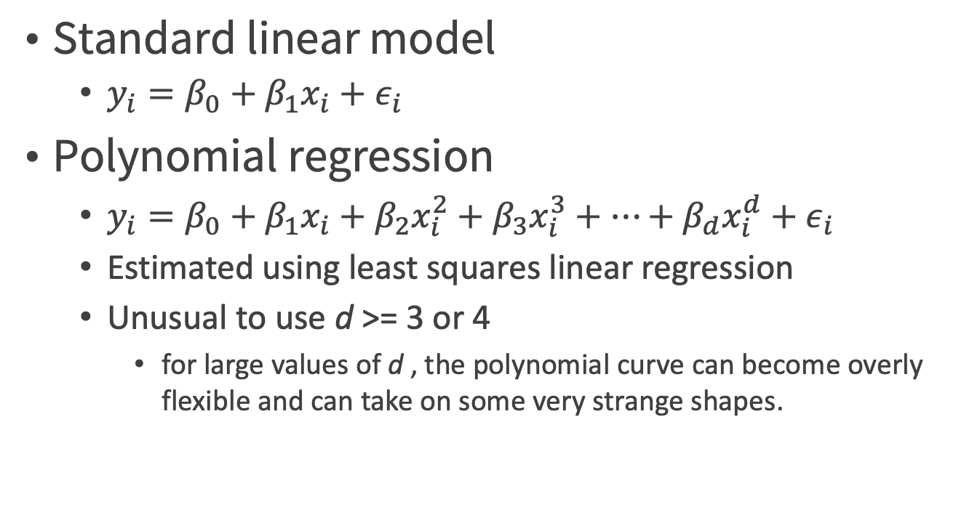
Polynomial Regression
Standard linear model
$y_{i}=β_{0}+β_{1}x_{i}+ε_{i}$
Polynomial regression
$y_{i}=β_{0}+β_{1}x_{i}+β_{2}x_{i}^{2}+β_{3}x_{i}^{3}+…+β_{d}x_{i}^{d}+ε_{i}$
Estimated using least squares linear regression
Unusual to use d >= 3 or 4
for large values of d , the polynomial curve can become overly flexible and can take on some very strange shapes.
An Introduction to Statistical Learning with Applications in R by Gareth James, Daniela Witten, Trevor Hastie, Robert Tibshirani

Slide 30
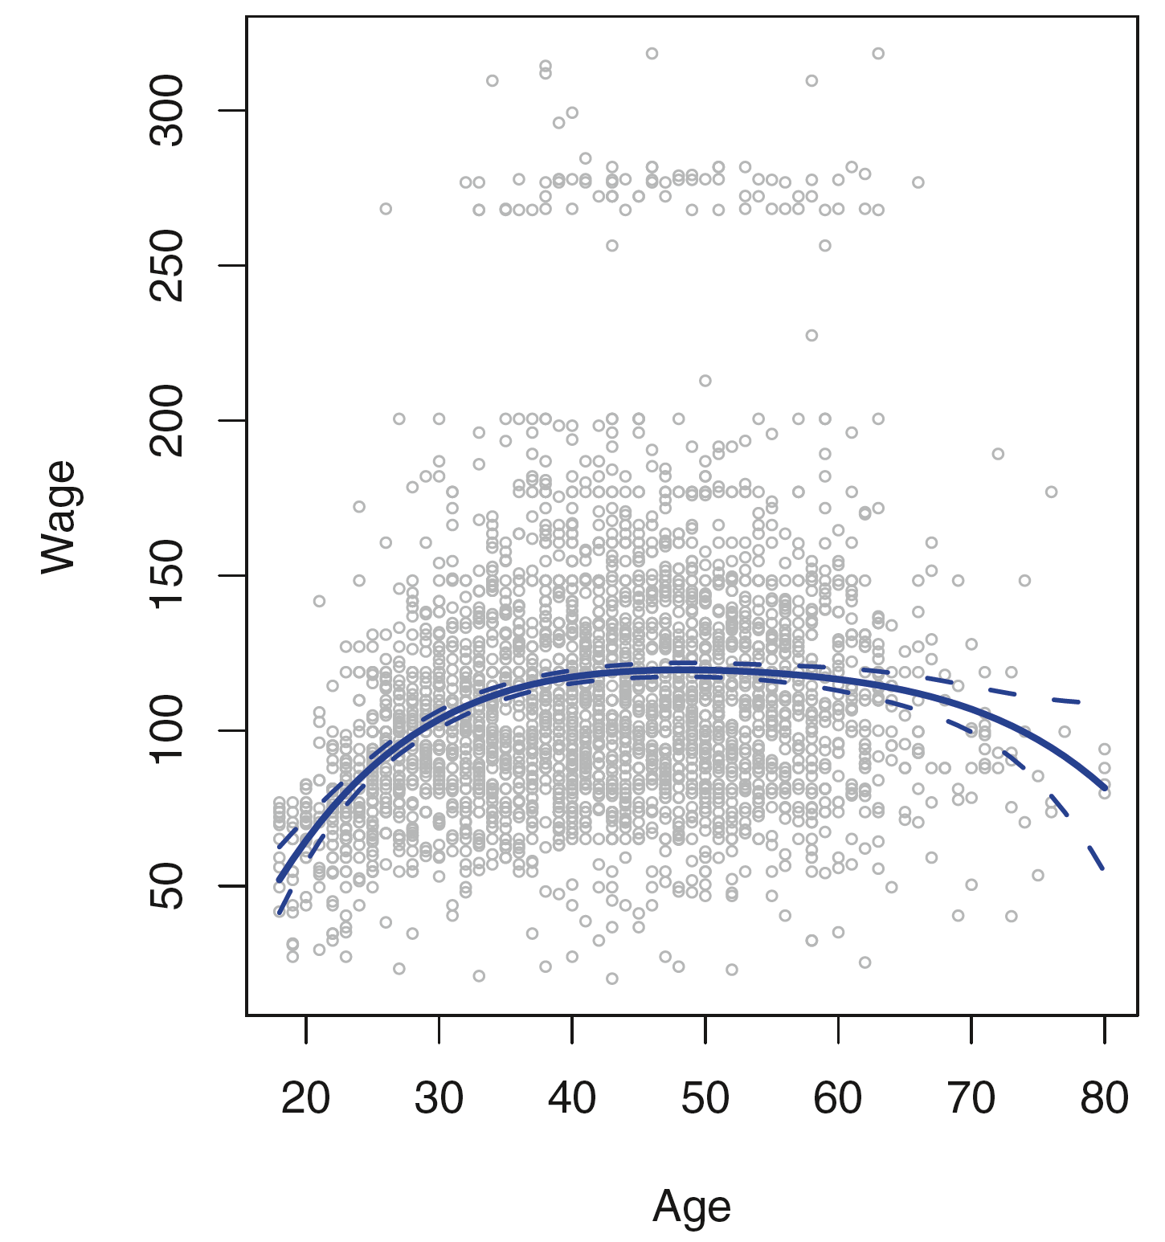
A degree-4 polynomial of wage as a function of age
The dotted curves indicate an estimated 95% confidence interval
Figure 7.1, An Introduction to Statistical Learning with Applications in R by Gareth James, Daniela Witten, Trevor Hastie, Robert Tibshirani

Slide 31
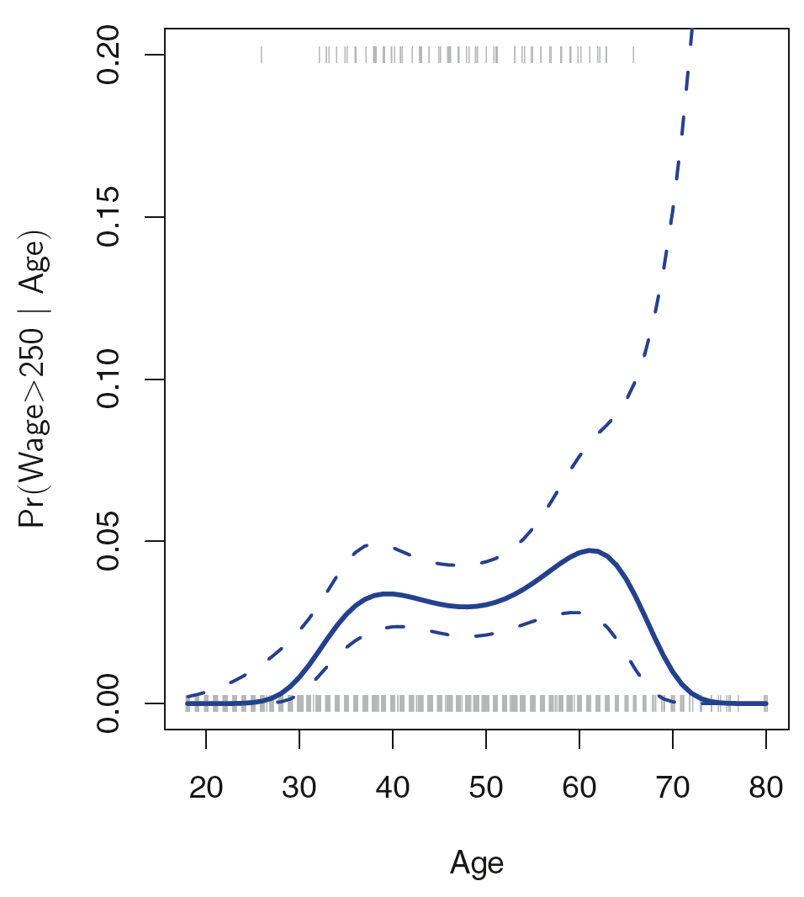
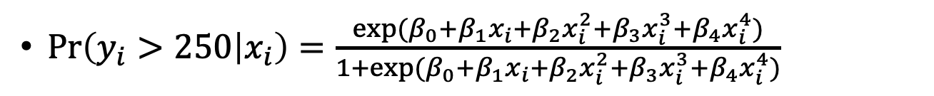
Logistic regression, again with a degree-4 polynomial
$\text{Pr}\left(y_{i}>250 | x_{i}\right)=\frac{exp⁡(β_{0}+β_{1}x_{i}+β_{2}x_{i}^{2}+β_{3}x_{i}^{3}+β_{4}x_{i}^{4})}{1+exp⁡(β_{0}+β_{1}x_{i}+β_{2}x_{i}^{2}+β_{3}x_{i}^{3}+β_{4}x_{i}^{4})}$
Figure 7.1, An Introduction to Statistical Learning with Applications in R by Gareth James, Daniela Witten, Trevor Hastie, Robert Tibshirani

Slide 32
Step Functions

Slide 33
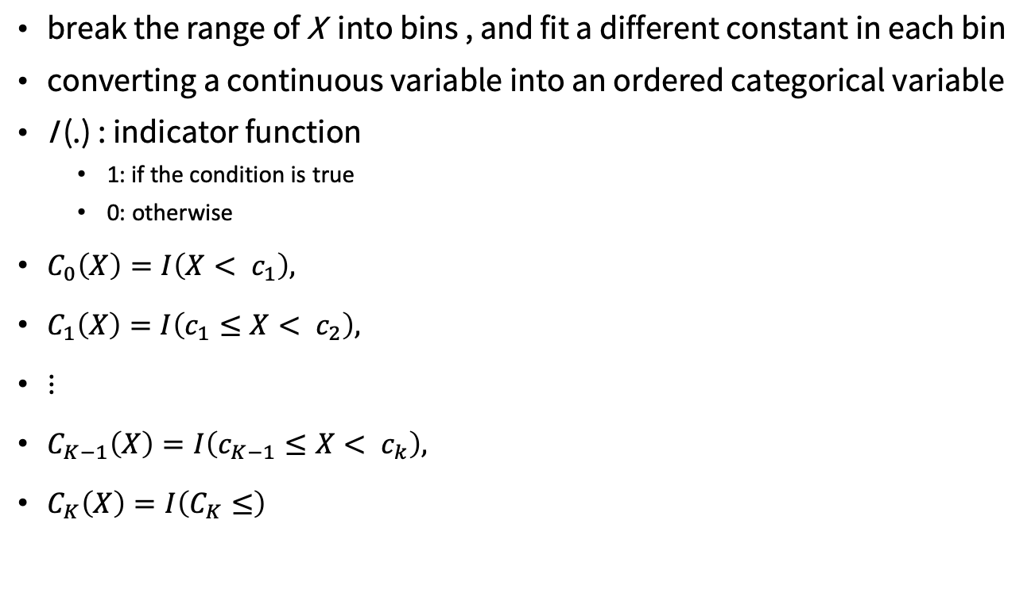
Step Functions
break the range of X into bins , and fit a different constant in each bin
converting a continuous variable into an ordered categorical variable
I (.) : indicator function
1: if the condition is true
0: otherwise
$C_{0}\left(X\right)=I\left(X< c_{1}\right),$
$C_{1}\left(X\right)=I\left(c_{1}≤X< c_{2}\right),$
$⋮$
$C_{K−1}\left(X\right)=I\left(c_{K−1}≤X< c_{k}\right),$
$C_{K}\left(X\right)=I\left(C_{K}≤\right)$
An Introduction to Statistical Learning with Applications in R by Gareth James, Daniela Witten, Trevor Hastie, Robert Tibshirani

Slide 34
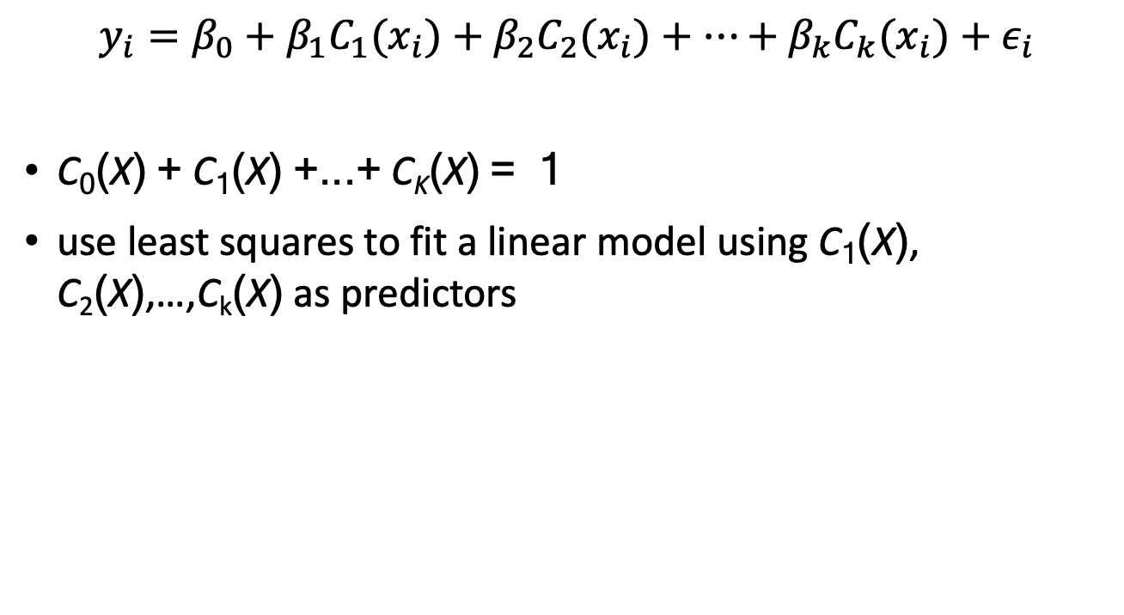
Step Functions
$$y_{i}=β_{0}+β_{1}{C_{1}(x}_{i})+β_{2}{C_{2}(x}_{i})+…+β_{k}{C_{k}(x}_{i})+ε_{i}$$
C₀(X) + C₁(X) +...+ C_{K}(X) = 1
use least squares to fit a linear model using C₁(X), C₂(X),…,C_{k}(X) as predictors
An Introduction to Statistical Learning with Applications in R by Gareth James, Daniela Witten, Trevor Hastie, Robert Tibshirani

Slide 35
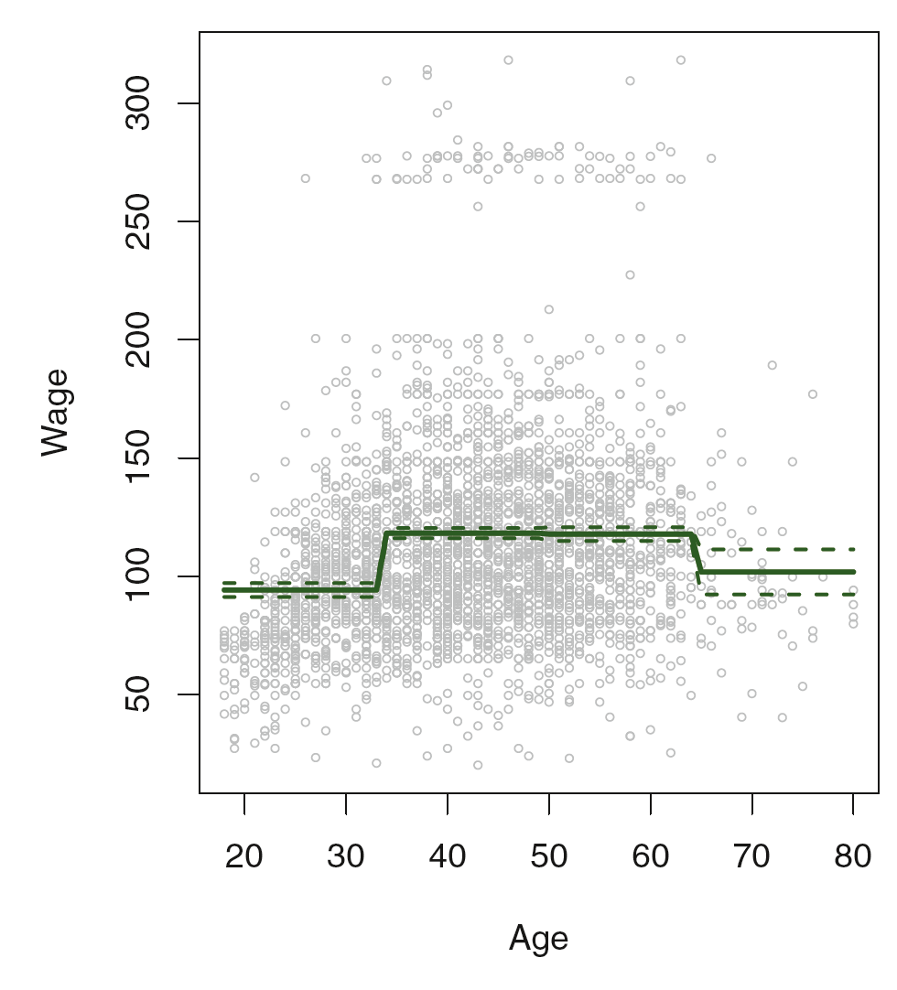
The fitted value from a least squares regression of wage using step functions of age
Figure 7.2, An Introduction to Statistical Learning with Applications in R by Gareth James, Daniela Witten, Trevor Hastie, Robert Tibshirani

Slide 36
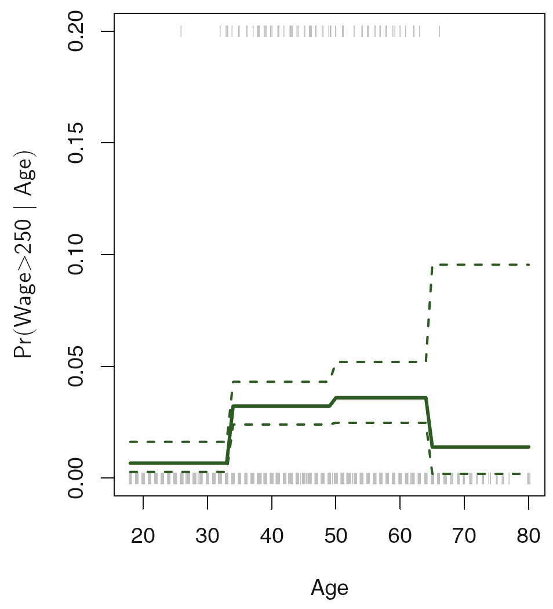
The binary event wage>250 using logistic regression, again using step functions of age
Figure 7.2, An Introduction to Statistical Learning with Applications in R by Gareth James, Daniela Witten, Trevor Hastie, Robert Tibshirani

Slide 37
Basis Functions

Slide 38
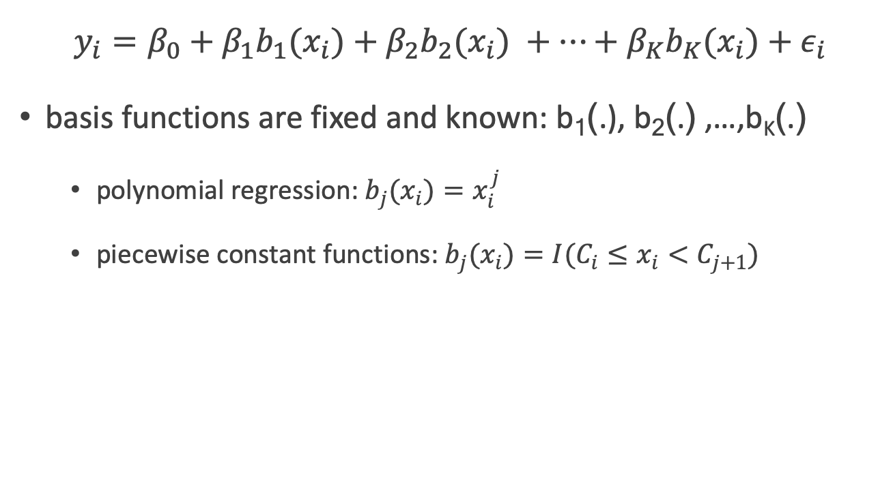
Basis Functions
$$y_{i}=β_{0}+β_{1}{b_{1}(x}_{i})+β_{2}{b_{2}(x}_{i}) +…+β_{K}{b_{K}(x}_{i})+ε_{i}$$
basis functions are fixed and known: b₁(.), b₂(.) ,…,b_{K}(.)
polynomial regression: $b_{j}(x_{i})=x_{i}^{j}$
piecewise constant functions: $b_{j}(x_{i})=I(C_{i}≤x_{i}<C_{j+1})$
An Introduction to Statistical Learning with Applications in R by Gareth James, Daniela Witten, Trevor Hastie, Robert Tibshirani

Slide 39
Regression Splines

Slide 40
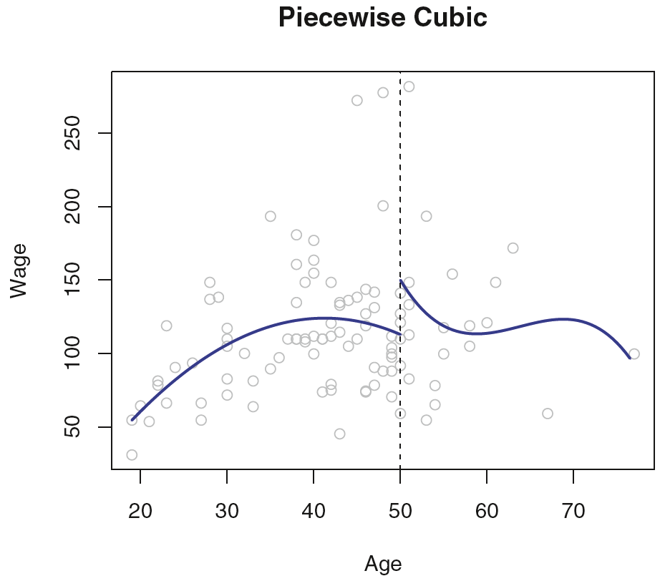
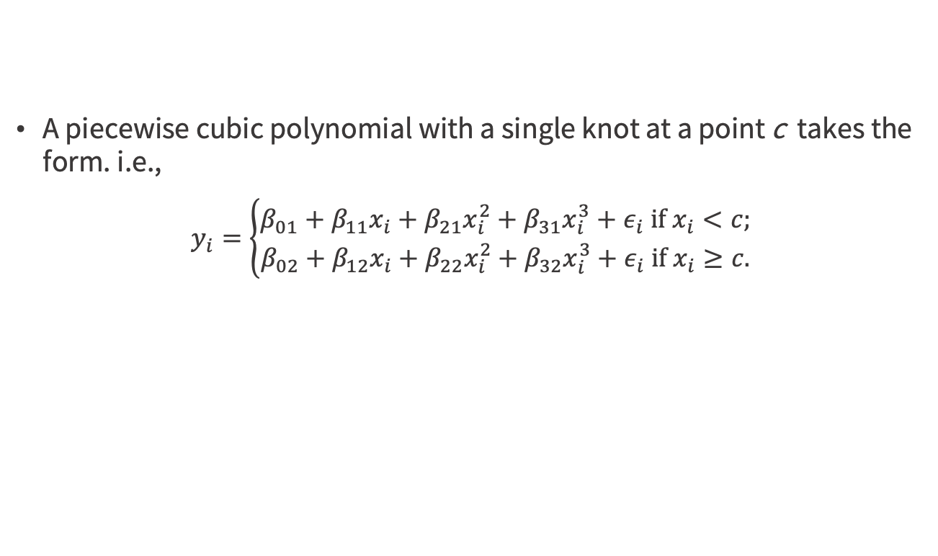
Piecewise Polynomials
A piecewise cubic polynomial with a single knot at a point c takes the form. i.e.,
$$y_{i}=\left\{\begin{matrix}β_{01}+β_{11}x_{i}+β_{21}x_{i}^{2}+β_{31}x_{i}^{3}+ε_{i} \text{if} x_{i}<c; \\ β_{02}+β_{12}x_{i}+β_{22}x_{i}^{2}+β_{32}x_{i}^{3}+ε_{i} \text{if} x_{i}≥c.\end{matrix}\right.$$
8 degrees of freedom
Figure 7.3, An Introduction to Statistical Learning with Applications in R by Gareth James, Daniela Witten, Trevor Hastie, Robert Tibshirani

Slide 41
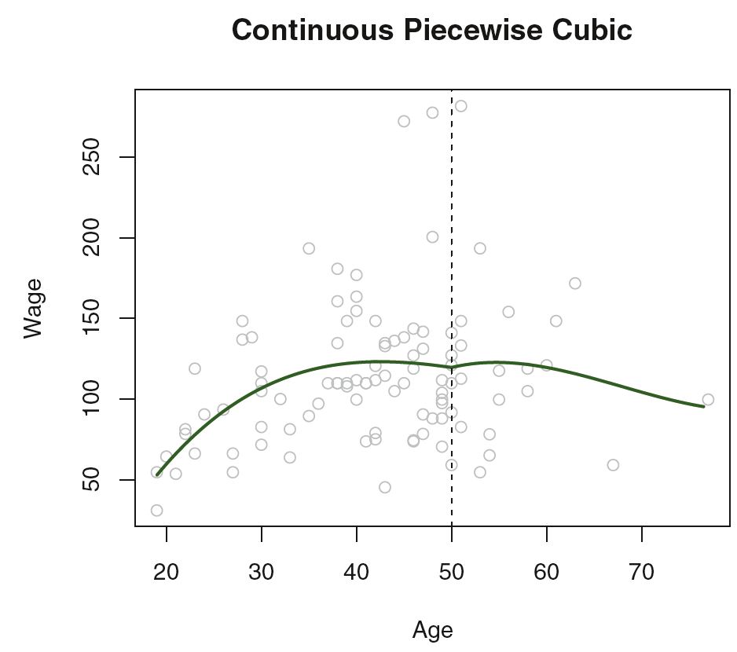
Constraints
constraint that the fitted curve must be continuous
there cannot be a jump when age=50
Figure 7.3, An Introduction to Statistical Learning with Applications in R by Gareth James, Daniela Witten, Trevor Hastie, Robert Tibshirani

Slide 42
Derivatives
the piecewise polynomial be not only continuous when age=50 , but also very smooth
Each constraint that we impose on the piecewise cubic polynomials effectively
free up 1 degree of freedom
reduce the complexity of the resulting piecewise polynomial fit
An Introduction to Statistical Learning with Applications in R by Gareth James, Daniela Witten, Trevor Hastie, Robert Tibshirani

Slide 43
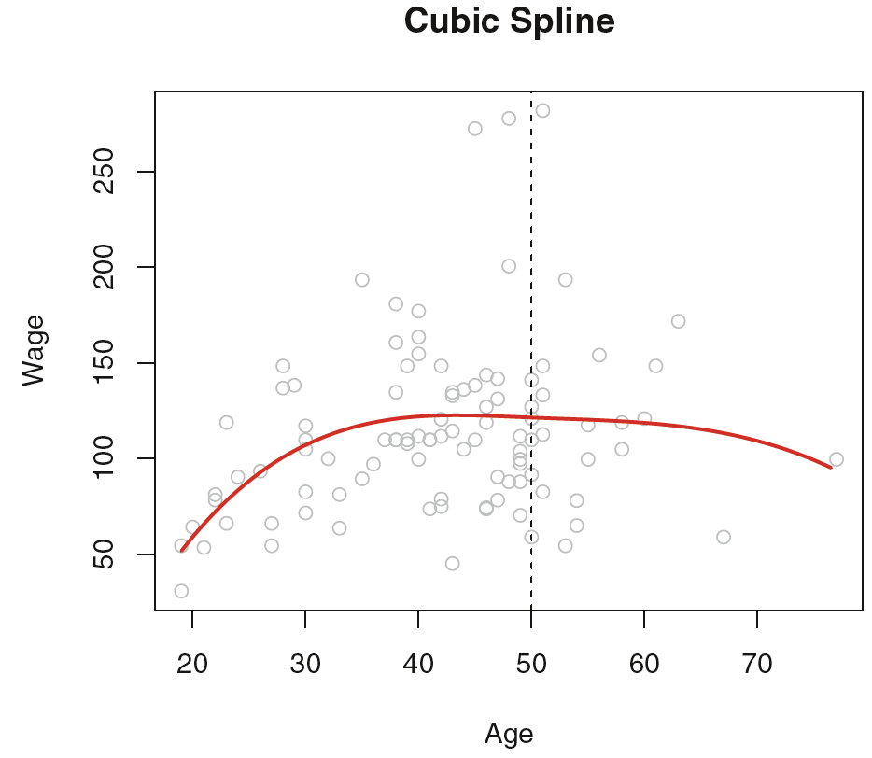
Cubic spline
three constraints
Continuity
continuity of the first derivative
continuity of the second derivative
5 degrees of freedom (=8-3)
Figure 7.3, An Introduction to Statistical Learning with Applications in R by Gareth James, Daniela Witten, Trevor Hastie, Robert Tibshirani

Slide 44
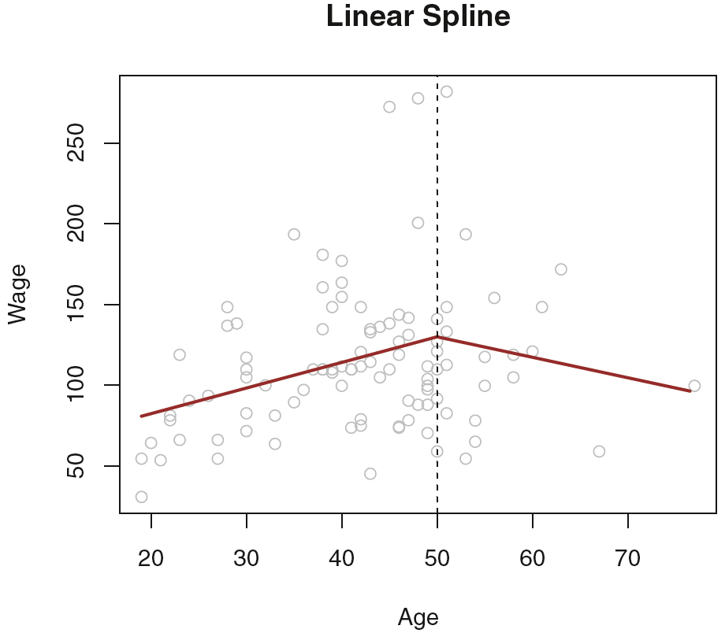
Linear spline
fit a line in each region of the predictor space defined by the knots, requiring continuity at each knot
Figure 7.3, An Introduction to Statistical Learning with Applications in R by Gareth James, Daniela Witten, Trevor Hastie, Robert Tibshirani

Slide 45
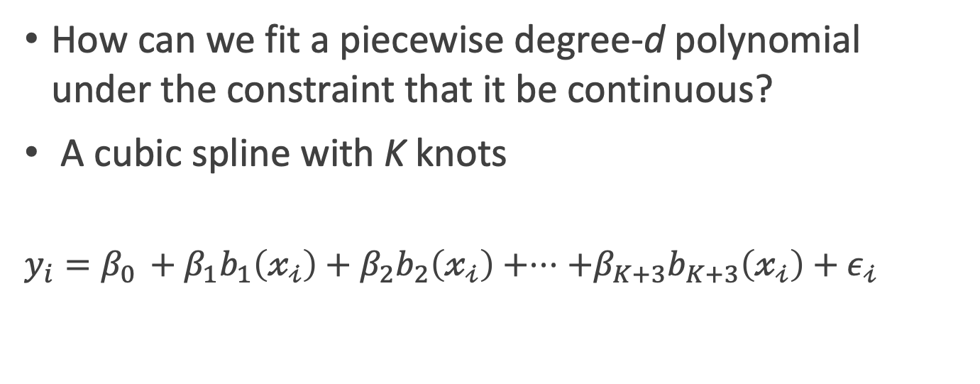
The Spline Basis Representation
How can we fit a piecewise degree-d polynomial under the constraint that it be continuous?
A cubic spline with K knots
$$y_{i}=β_{0 }+β_{1}b_{1}\left(𝓍_{𝒾}\right)+β_{2}b_{2}\left(𝓍_{𝒾}\right)+⋅⋅⋅+β_{K+3}b_{K+3}\left(𝓍_{𝒾}\right)+ε_{𝒾}$$
An Introduction to Statistical Learning with Applications in R by Gareth James, Daniela Witten, Trevor Hastie, Robert Tibshirani

Slide 46
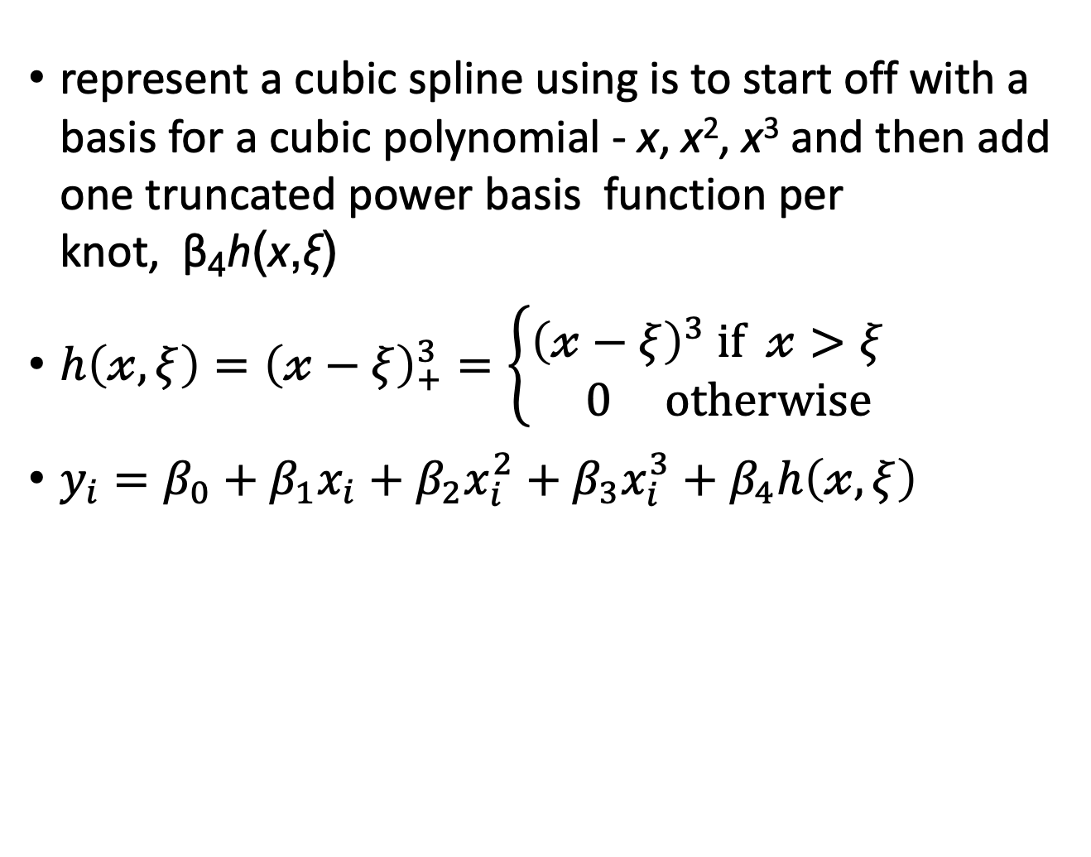
Truncated power basis
represent a cubic spline using is to start off with a basis for a cubic polynomial - x, x², x³ and then add one truncated power basis function per knot, β₄h(x,ξ)
$h\left(𝓍,ξ\right)={\left(𝓍−ξ\right)}_{+}^{3}=\left\{\begin{aligned}{\left(𝓍−ξ\right)}^{3} if 𝓍>ξ \\ 0 otherwise\end{aligned}\right.$
$y_{i}=β_{0}+β_{1}x_{i}+β_{2}x_{i}^{2}+β_{3}x_{i}^{3}+$ $β_{4}h\left(𝓍,ξ\right)$
An Introduction to Statistical Learning with Applications in R by Gareth James, Daniela Witten, Trevor Hastie, Robert Tibshirani

Slide 47
Degrees of freedom
K knots, we perform least squares regression with an intercept and 3 + K predictors
X, X², X³ , h(X,ξ₁), h(X,ξ₂),…,h(X,ξ_{K}), where ξ₁,…, ξ_{K} are the knots
a total of K+ 4 regression coefficients
for this reason, fitting a cubic spline with K knots uses K+4 degrees of freedom
An Introduction to Statistical Learning with Applications in R by Gareth James, Daniela Witten, Trevor Hastie, Robert Tibshirani

Slide 48
Degrees of freedom
for this reason, fitting a cubic spline with K knots uses K+4 degrees of freedom
1 knot => 1+4=5 degrees of freedom
An Introduction to Statistical Learning with Applications in R by Gareth James, Daniela Witten, Trevor Hastie, Robert Tibshirani

Slide 49
Degrees of freedom
K+4 degrees of freedom
5 degrees of freedom = 8-3
Figure 7.3, An Introduction to Statistical Learning with Applications in R by Gareth James, Daniela Witten, Trevor Hastie, Robert Tibshirani

Slide 50
Generalized Additive Models (GAMs)

Slide 51
Linear & logistic regression
Linear and logistic regression models are powerful tools to understand the relationship between the input variables and the output.
They’re robust to correlated variables (when regularized), and logistic regression preserves the marginal probabilities of the data.
Practical Data Science with R by Nina Zumel, John Mount

Slide 52
Drawbacks of the linear & logistic regression
BUT, assume that the relationship between the inputs and the output is monotone.
if more is good, than much more is always better.
However, for underweight patients, increasing weight can increase health.
But there’s a limit: at some point more weight is bad.
Practical Data Science with R by Nina Zumel, John Mount

Slide 53
Generalized additive models (GAMs)
a way to model non-monotone responses within the framework of a linear or logistic model (or any other generalized linear model)
Original form : f(x[i,]) = b0 + b[1] x[i,1] + b[2] x[i,2] + ... b[n] x[i,n]
y[i] is the numeric quantity you want to predict
x[i,] is a row of inputs that corresponds to output y[i]
Practical Data Science with R by Nina Zumel, John Mount

Slide 54
Generalized additive models (GAMs)
f(x[i,])= a0 + s₁(x[i,1]) + s₂(x[i,2]) + ... +s_{n}(x[i,n])
relaxes the linearity constraint
finds a set of functions s_{i}(), smooth curve (splines) fits that are built up from polynomials.
The splines are designed to pass as closely as possible through the data without being too wiggly (without overfitting).
Practical Data Science with R by Nina Zumel, John Mount

Slide 55
Smoothing Splines

Slide 56
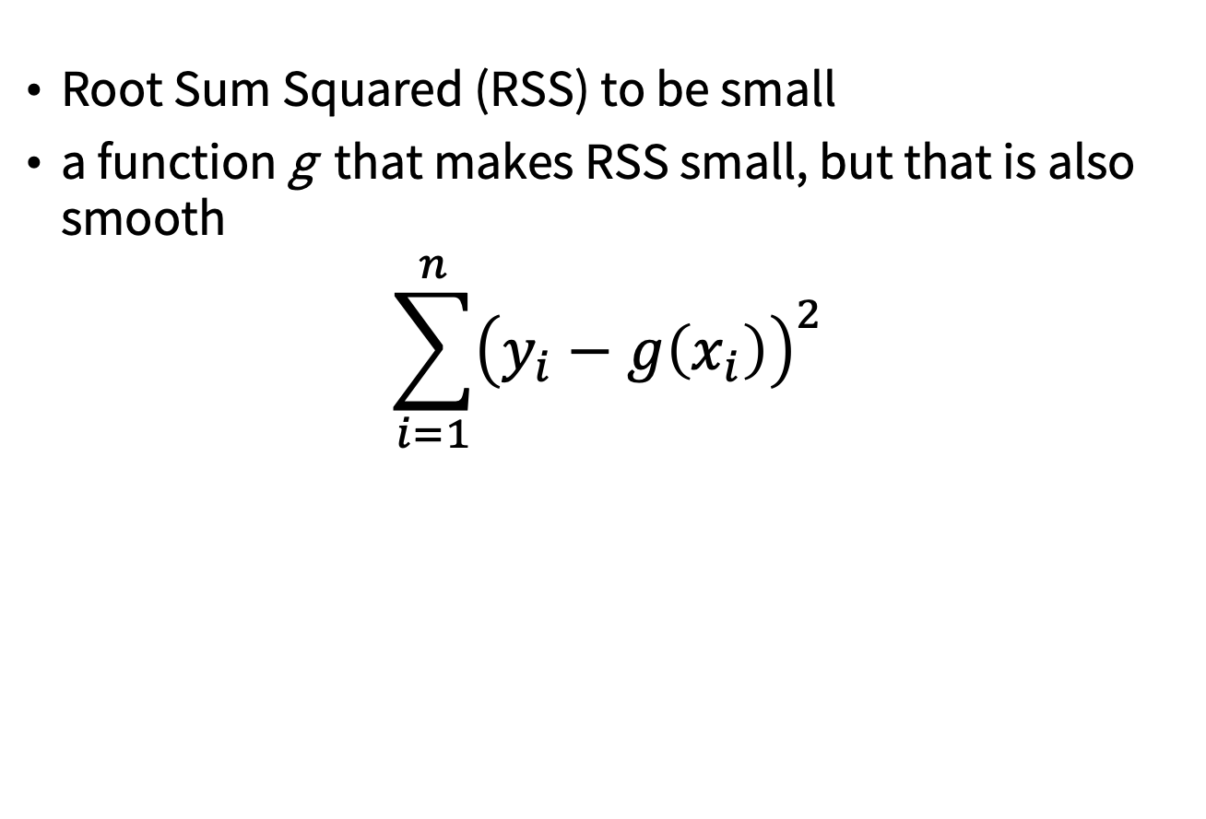
A smooth curve
Root Sum Squared (RSS) to be small
a function g that makes RSS small, but that is also smooth
$$\sum_{i=1}^{n}{{\left(y_{i}−g\left(x_{i}\right)\right)}^{2}}$$
An Introduction to Statistical Learning with Applications in R by Gareth James, Daniela Witten, Trevor Hastie, Robert Tibshirani

Slide 57
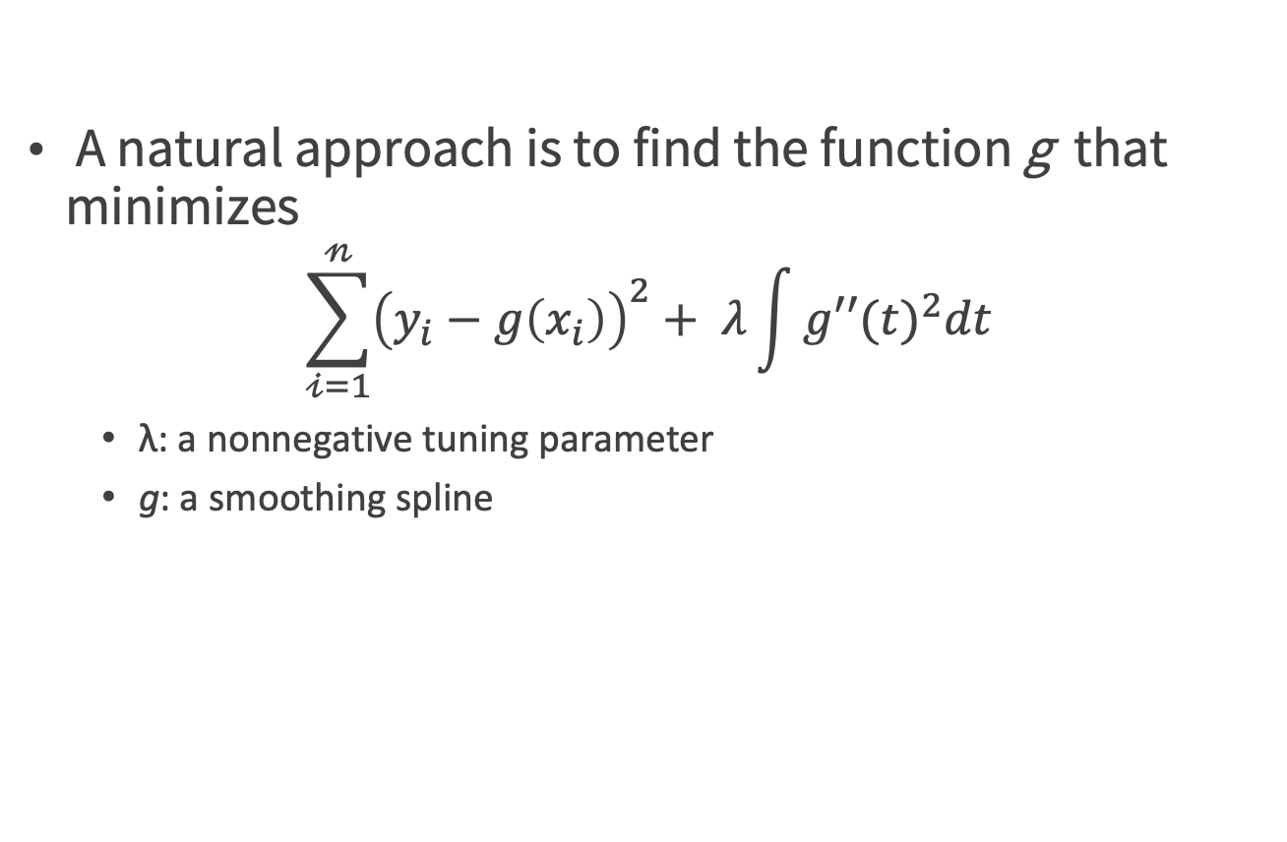
A smooth spline
A natural approach is to find the function g that minimizes
$$\sum_{𝒾=1}^{𝓃}{{\left(y_{i}−g\left(x_{i}\right)\right)}^{2}+ λ\int{g′′{(t)}^{2}dt}}$$
λ: a nonnegative tuning parameter
g: a smoothing spline
An Introduction to Statistical Learning with Applications in R by Gareth James, Daniela Witten, Trevor Hastie, Robert Tibshirani

Slide 58
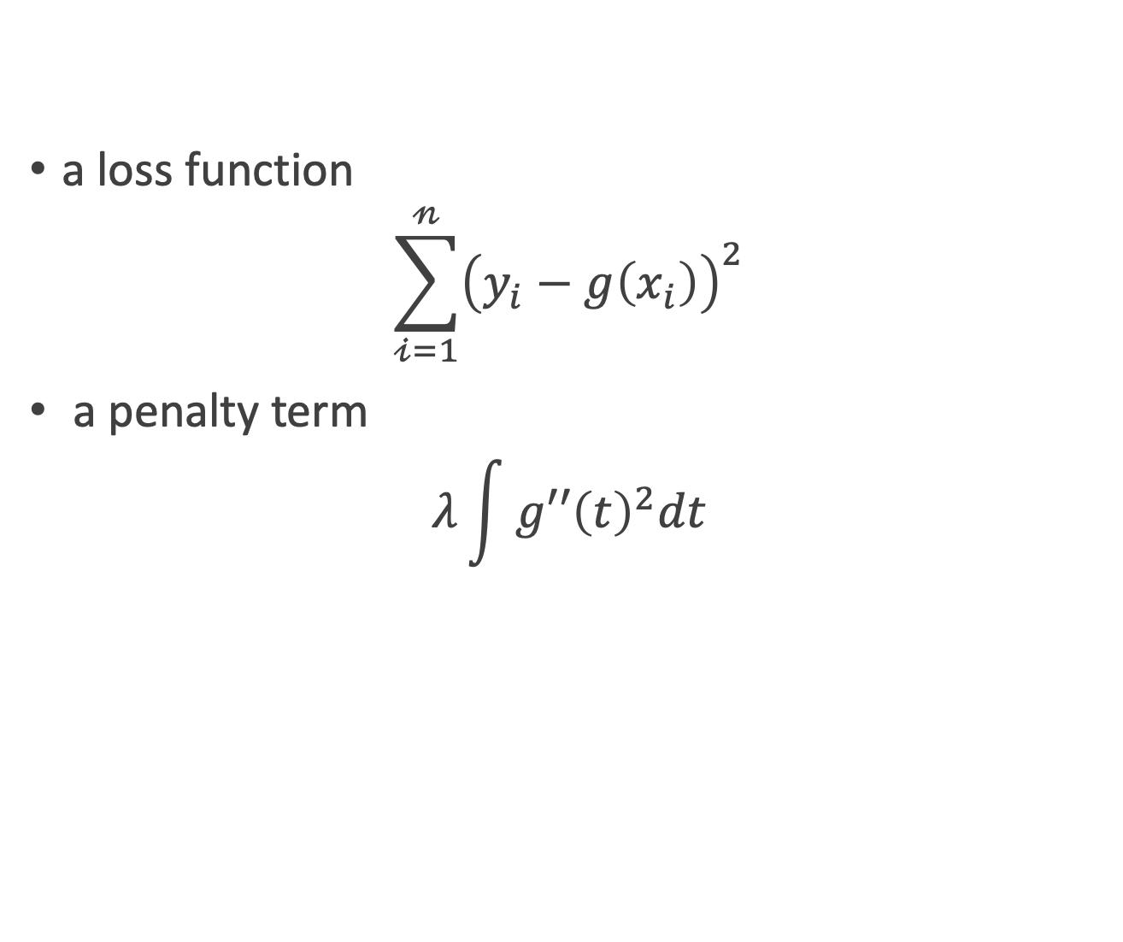
Loss+Penalty
a loss function
$$\sum_{𝒾=1}^{𝓃}{{\left(y_{i}−g\left(x_{i}\right)\right)}^{2}}$$
a penalty term
$$λ\int{{g′′\left(t\right)}^{2}dt}$$
An Introduction to Statistical Learning with Applications in R by Gareth James, Daniela Witten, Trevor Hastie, Robert Tibshirani

Slide 59
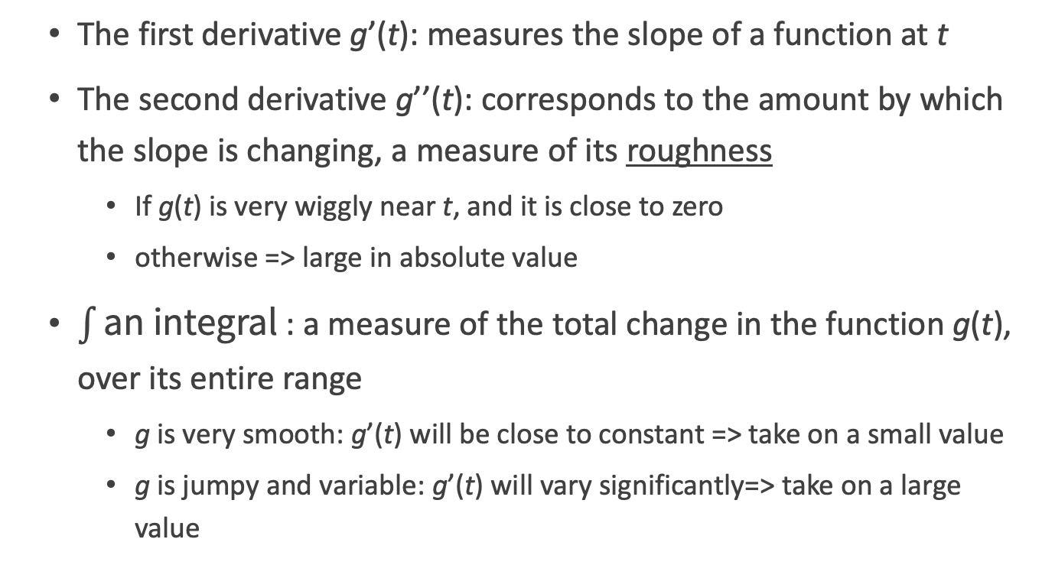

A penalty term $λ\int{{g′′\left(t\right)}^{2}dt}$
The first derivative g’(t): measures the slope of a function at t
The second derivative g’’(t): corresponds to the amount by which the slope is changing, a measure of its roughness
If g(t) is very wiggly near t, and it is close to zero
otherwise => large in absolute value
$\int{\text{an} \text{integral}}$: a measure of the total change in the function g(t), over its entire range
g is very smooth: g’(t) will be close to constant => take on a small value
g is jumpy and variable: g’(t) will vary significantly=> take on a large value
An Introduction to Statistical Learning with Applications in R by Gareth James, Daniela Witten, Trevor Hastie, Robert Tibshirani

Slide 60
GAMs in practice

Slide 61
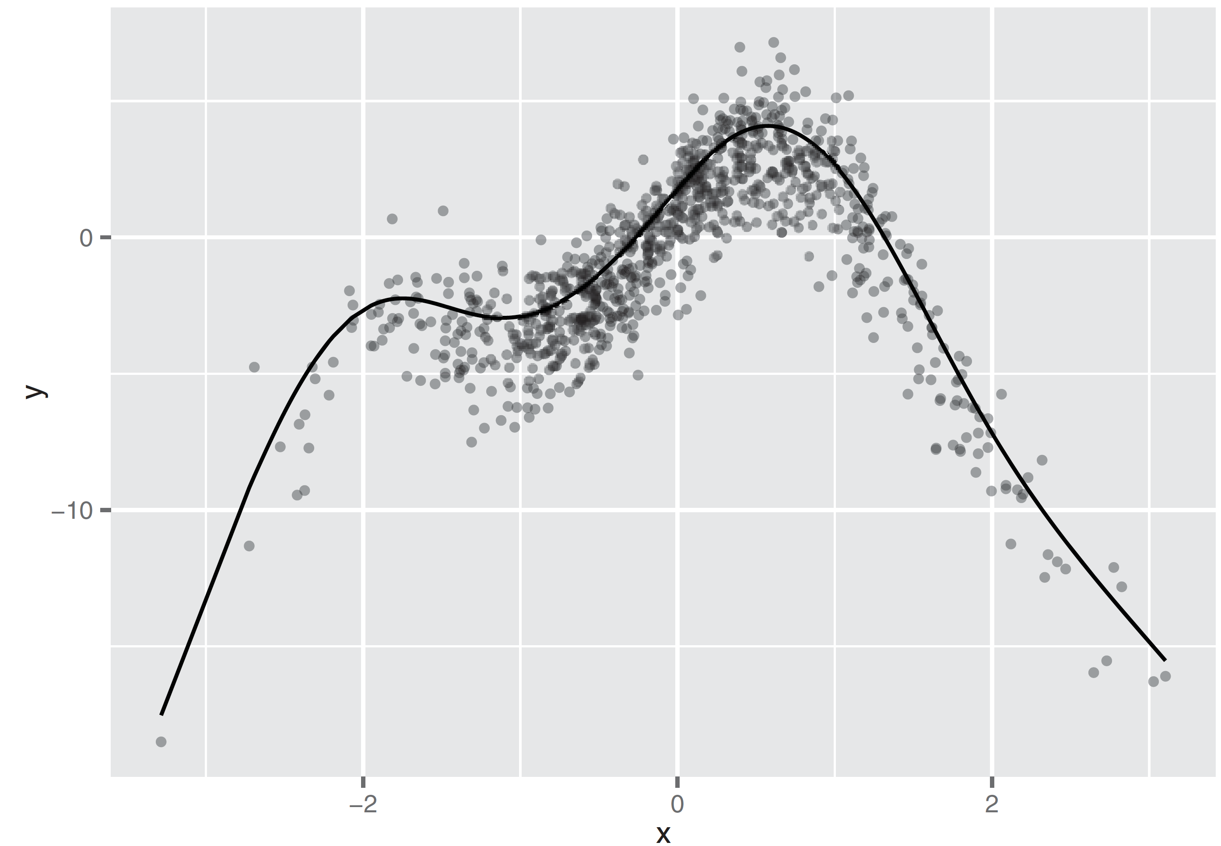
A spline
Figure 9.2, Practical Data Science with R by Nina Zumel, John Mount

Slide 62
Preparing an artificial problem
gam.R
set.seed(602957)
x <- rnorm(1000)
noise <- rnorm(1000, sd=1.5)
y <- 3*sin(2*x)+cos(0.75*x)-1.5*(x^2)+noise
select <- runif(1000)
frame <- data.frame(y=y, x = x)
train <- frame[select > 0.1,]
test <-frame[select <= 0.1,]
Practical Data Science with R by Nina Zumel, John Mount

Slide 63
Linear regression applied to our artificial example
lin.model <- lm(y ~ x, data=train)
summary(lin.model)
#calculate the root mean squared error (rmse)
resid.lin <- train$y-predict(lin.model)
sqrt(mean(resid.lin^2))
Practical Data Science with R by Nina Zumel, John Mount

Slide 64
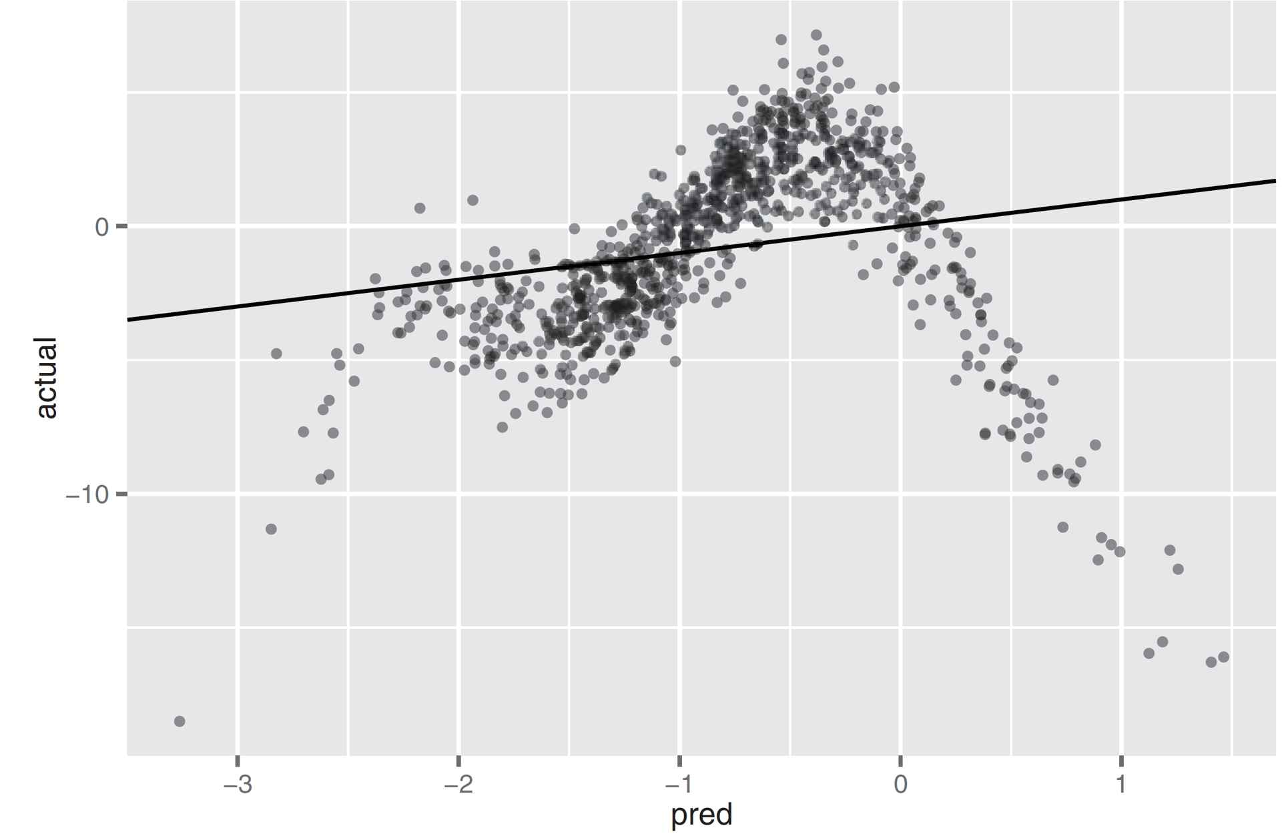
Response vs. Prediction by linear model
R ² = ~ 0.04 => a very poor fit
Heteroscedastic
regions where the model systematically underpredicts
regions where it systematically overpredicts.
Figure 9.3, Practical Data Science with R by Nina Zumel, John Mount

Slide 65
GAM applied to our artificial example
library(mgcv)
glin.model <- gam(y~s(x), data=train)
y ~ x => the same with lm
glin.model$converged
The converged parameter tells you if the algorithm converged. You should only trust the output if this is TRUE.
Practical Data Science with R by Nina Zumel, John Mount

Slide 66
GAM applied to our artificial example
summary(glin.model)
the smooth terms are the nonlinear terms.
the effective degrees of freedom (edf) used up to build each smooth term
near 1 indicates that the variable has an approximately linear relationship to the output
R-sq (adj) = adjusted R-squared.
Deviance explained = the raw R-squared (0.834)
Practical Data Science with R by Nina Zumel, John Mount

Slide 67
GAM applied to our artificial example
calculate the root mean squared error (rmse)
resid.glin <- train$y-predict(glin.model)
sqrt(mean(resid.glin^2))

Slide 68
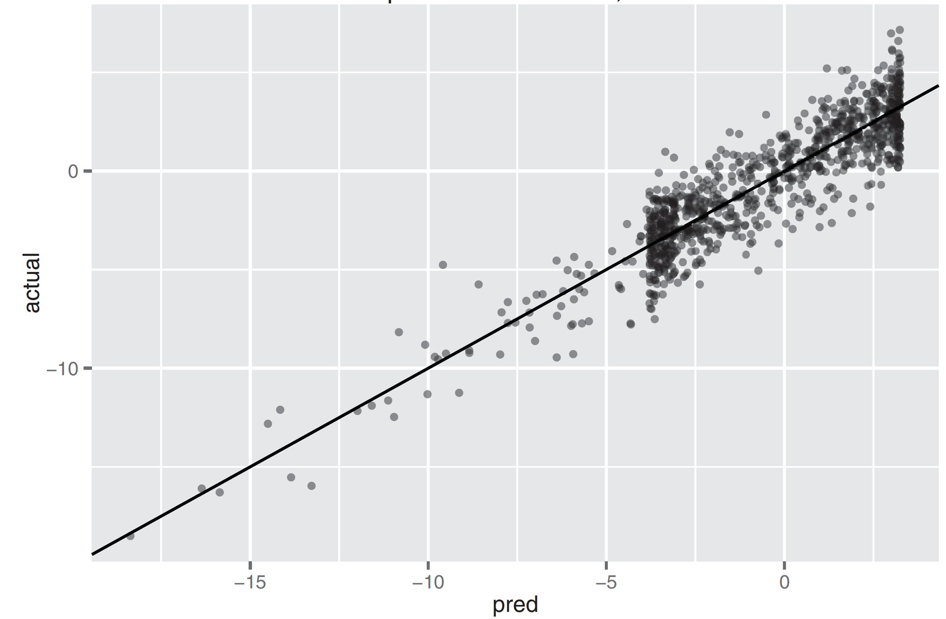
Response vs. Prediction by GAM
R-squared of 0.83
the model explains over 80% of the variance
RMSE = 1.448514
over the training data is less than half the RMSE of the linear model (= 3.481091)
Homoscedastic
any given prediction is as likely to be an overprediction as an underprediction
Figure 9.4, Practical Data Science with R by Nina Zumel, John Mount

Slide 69
Comparing linear regression and GAM performance on test data
actual <- test$y
pred.lin <- predict(lin.model, newdata=test)
pred.glin <- predict(glin.model,newdata=test)
resid.lin <- actual-pred.lin
resid.glin <- actual-pred.glin
Practical Data Science with R by Nina Zumel, John Mount

Slide 70
Comparing linear regression and GAM performance on test data
Compare the RMSE
sqrt(mean(resid.lin^2))
sqrt(mean(resid.glin^2))
Compare the R-squared
cor(actual, pred.lin)^2
cor(actual, pred.glin)^2
Any overfitting?
Practical Data Science with R by Nina Zumel, John Mount

Slide 71
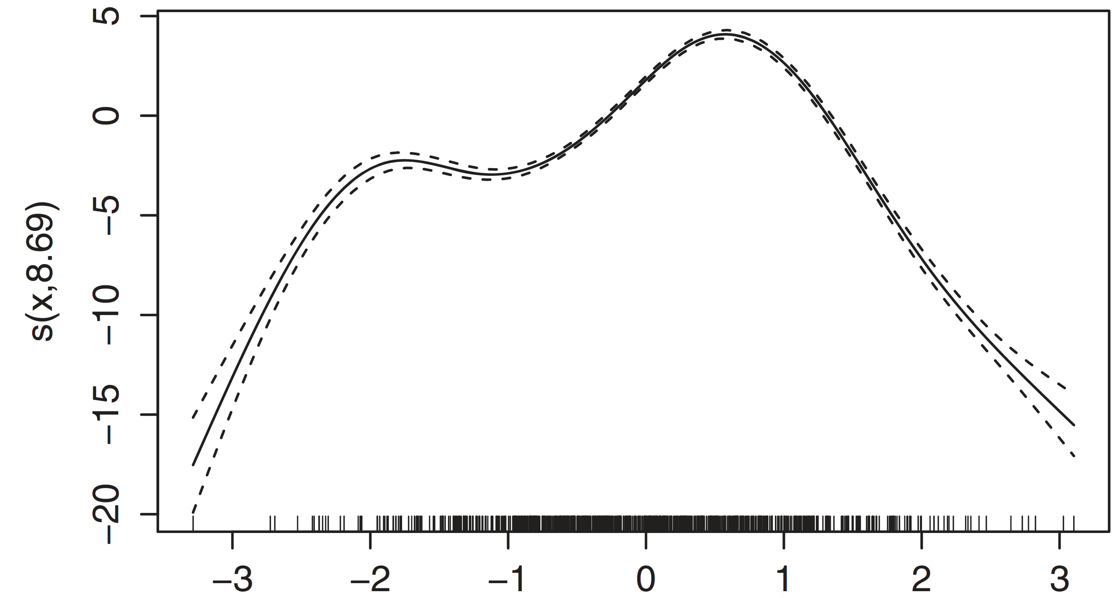
Extracting the nonlinear relationships
plot(glin.model)
Figure 9.5, Practical Data Science with R by Nina Zumel, John Mount

Slide 72
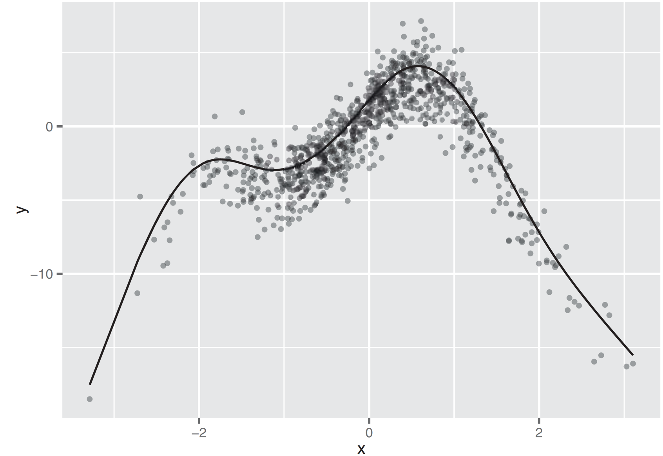
Extracting a learned spline from a GAM
sx <- predict(glin.model, type="terms")
summary(sx)
xframe <- cbind(train, sx=sx[,1])
ggplot(xframe, aes(x=x)) + geom_point(aes(y=y), alpha=0.4) + geom_line(aes(y=sx))
Figure 9.5, Practical Data Science with R by Nina Zumel, John Mount

Slide 73
CDC 2010 natality dataset
predict a newborn baby’s weight (DBWT )
mother’s weight (PWGT )
mother’s pregnancy weight gain (WTGAIN )
mother’s age (MAGER )
the number of prenatal medical visits (UPREVIS )
https://github.com/WinVector/zmPDSwR/blob/master/CDC/NatalBirthData.rData

Slide 74
Using GAM on actual data
newBornWei/predBornWei.R
library(mgcv)
library(ggplot2)
load("NatalBirthData.rData")
train <- sdata[sdata$ORIGRANDGROUP<=5,]
test <- sdata[sdata$ORIGRANDGROUP>5,]
Practical Data Science with R by Nina Zumel, John Mount

Slide 75
Using linear on actual data
Build a linear model with four variables.
form.lin <- as.formula("DBWT ~ PWGT + WTGAIN + MAGER + UPREVIS")
linmodel <- lm(form.lin, data=train)
summary(linmodel)
Practical Data Science with R by Nina Zumel, John Mount

Slide 76
Using GAM on actual data
Build a GAM with the same variables
form.glin <- as.formula("DBWT ~ s(PWGT) + s(WTGAIN) + s(MAGER) + s(UPREVIS)")
glinmodel <- gam(form.glin, data=train)
glinmodel$converged
summary(glinmodel)
Practical Data Science with R by Nina Zumel, John Mount

Slide 77
Plotting GAM results
terms <- predict(glinmodel, type="terms")
tframe <- cbind(DBWT = train$DBWT, as.data.frame(terms))
colnames(tframe) <- gsub('[()]', '', colnames(tframe))
pframe <- cbind(tframe, train[,c("PWGT", "WTGAIN", "MAGER", "UPREVIS")])
ggplot(pframe, aes(x=PWGT)) + geom_point(aes(y=scale(sPWGT, scale=F))) + geom_smooth(aes(y=scale(DBWT, scale=F)))
Practical Data Science with R by Nina Zumel, John Mount

Slide 78
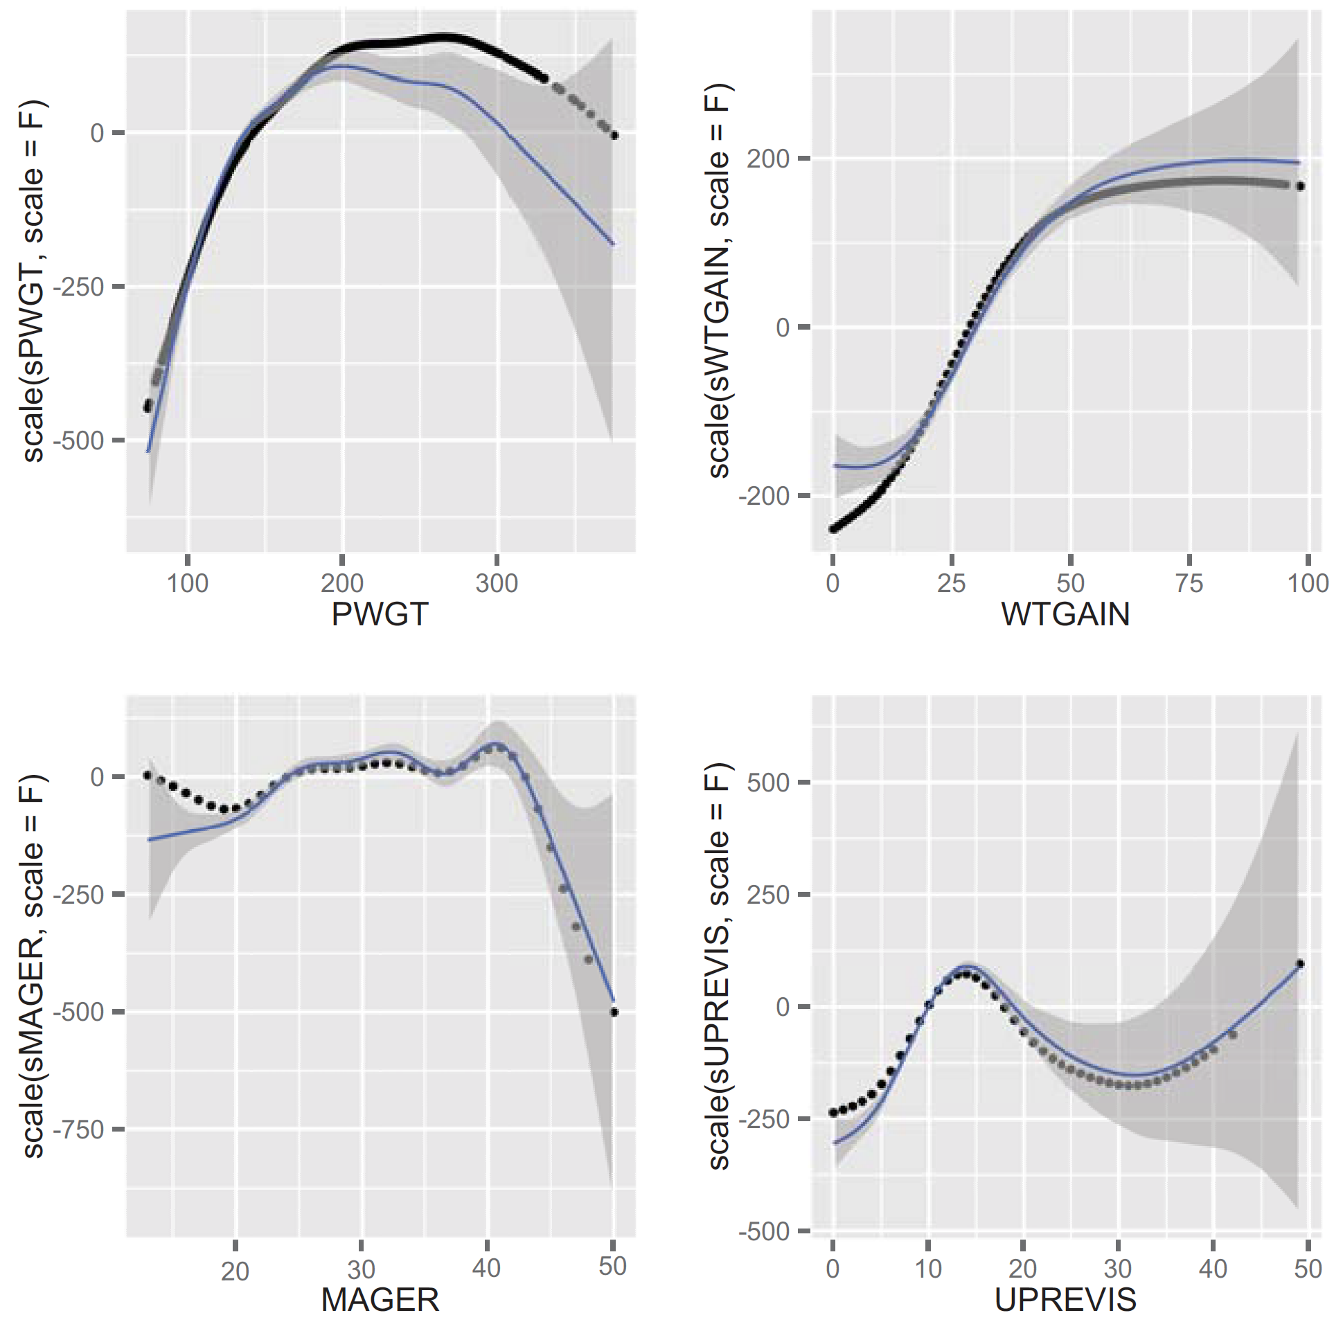
Plotting GAM results
Figure 9.6, Practical Data Science with R by Nina Zumel, John Mount

Slide 79
Checking GAM model performance on hold-out data
pred.lin <- predict(linmodel,newdata=test)
pred.glin<- predict(glinmodel,newdata=test)
Calculate R-squared
cor(pred.lin, test$DBWT)^2
cor(pred.glin, test$DBWT)^2
Any overfitting?
Practical Data Science with R by Nina Zumel, John Mount

Slide 80
Using GAM for logistic regression
predict the birth of underweight babies (defined as DBWT < 2000 )
GLM logistic regression
form <- as.formula("DBWT < 2000 ~ PWGT + WTGAIN + MAGER + UPREVIS")
logmod <- glm(form, data=train, family=binomial(link="logit"))
Practical Data Science with R by Nina Zumel, John Mount

Slide 81
Using GAM for logistic regression
predict the birth of underweight babies (defined as DBWT < 2000 )
GAM logistic regression
form2 <- as.formula("DBWT<2000~s(PWGT)+s(WTGAIN)+s(MAGER)+s(UPREVIS)")
glogmod <- gam(form2, data=train,family=binomial(link="logit"))
glogmod$converged
summary(glogmod)
Practical Data Science with R by Nina Zumel, John Mount

Slide 82
GAM takeaways
GAM s let you represent nonlinear and non-monotonic relationships between variables and outcome in a linear or logistic regression framework.
In the mgcv package, you can extract the discovered relationship from the GAM model using the predict() function with the type="terms" parameter.
Practical Data Science with R by Nina Zumel, John Mount

Slide 83
GAM takeaways
You can evaluate the GAM with the same measures you’d use for standard linear or logistic regression: residuals, deviance, R-squared, and pseudo R-squared.
The gam() summary also gives you an indication of which variables have a significant effect on the model.
Because GAM s have increased complexity compared to standard linear or logistic regression models, there’s more risk of overfit.
Practical Data Science with R by Nina Zumel, John Mount

Slide 84

Thank You Any Question?

